Slide 1
Reinforcement Project
Point of Sale
PRESENTATION BY
ABINAV S

Slide 2

POINT OF SALE
What is pos ?
A point of sale (PoS) is the place where sales are made. On a macro level, a POINT OF SALE may be a mall, a market or a city. On a micro level, retailers consider a PoS to be the area where a customer completes a transaction, such as a checkout counter. It is also known as a point of purchase.

Slide 3
advantage
Better Inventory Management
Simple Invoicing
Quick Payments
Better Customer Management
Better Customer Orders
Better Purchasing / Supplier Order Management
Better Customer Experience
Better Customer Satisfaction & Loyalty

Slide 4
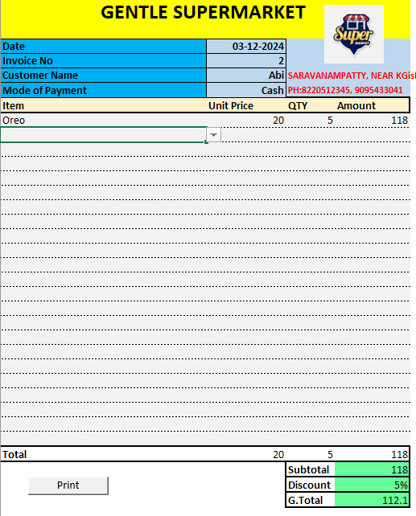
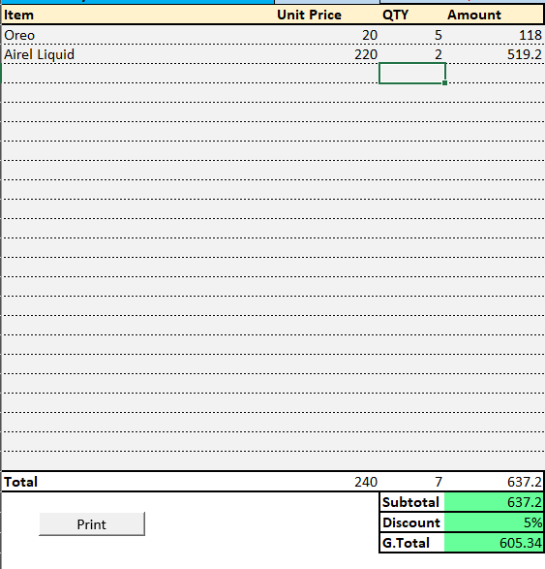
Interface

Slide 5
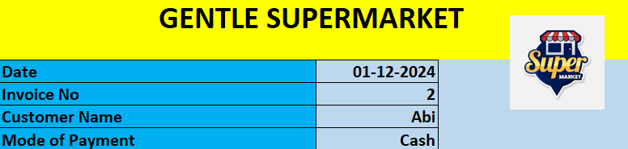

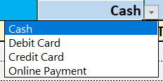
Billing Details

Slide 6
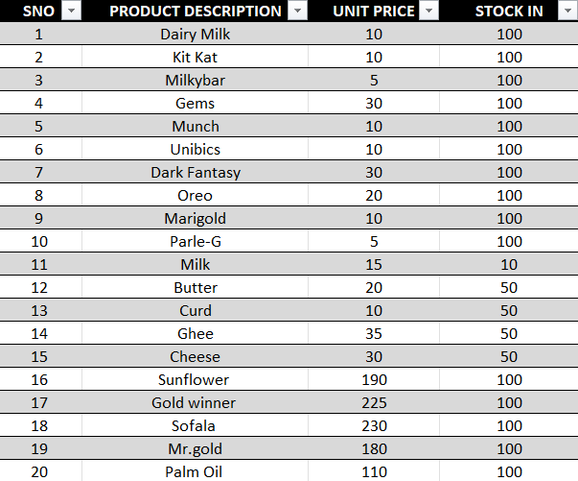
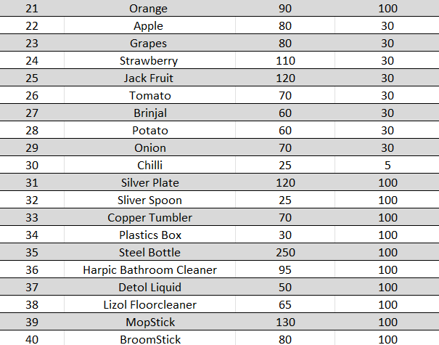
Stock In Products

Slide 7

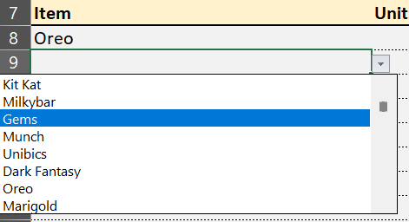
Product Details
Product Name
Unit Price & Quantity
The Unit Price is Mentioned in the Stock list according to the Product and Quantity can be Entered Manually

Slide 8


Product Price

Slide 9
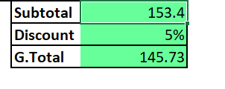


Checkout

Slide 10


